Slide 1
WEB TECHNOLOGIES

Slide 2


PHYSICAL LAYER
The function of physical layer is to established the physical connection between two computer
The physical connection can be established through mobile network, direct wire, Bluetooth,
wifi
DATALINK LAYER
The function of datalink layer to make sure that information is transferred correctly

Slide 3
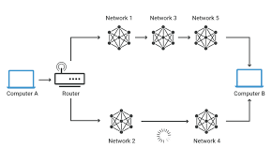

NETWORK LAYER
computer to computer routing
TRANSPORT LAYER
program to program routing

Slide 4
TCP , UDP ( transmission control protocol)
program to program routing
Its is used to find the particular program using port number
IP ( internet protocol address )
Computer to computer routing
Its is used to find computer using IP address
LLC (logical link layer)
To make secure that information is transferred correctly
MAC ( media access control address )
To established physical connection between two layer

Slide 5
IP ADDRESS
It is to used connect the computer (or) any other devices using IP address
PORT NUMBER
It is used to find the particular program using port number
URL (uniform resources locator
Its is unique resource on the web browser
DNS ( domain name system )

Slide 6

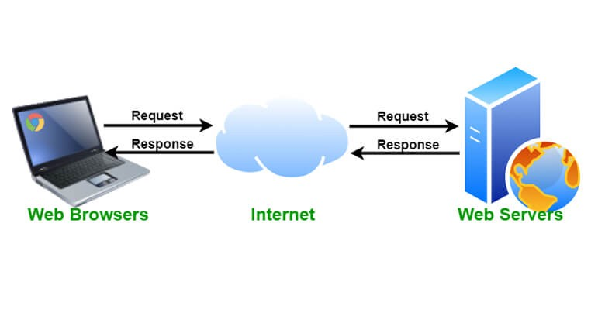
WEB CLIENT
Who put the request to web server
WEB SEVER
Who services the request

Slide 7

WEB BROWSER
Its is a software application that enables the user to view web pages navigate web sites
different types of web browser
google chrome
Internet explore
Mozilla firefox
Netscape navigator

Slide 8
HTTP ( hyper text transferred protocol )
Its is used transfer the html files , text to web sever
SMTP (simple mail transfer protocol )
Its is used to send or receive mail
SSH ( secure socket shell )
Its is used to communicate between the two computer
SNMP ( simple network management protocol )
Its is used manage the network devices

Slide 9
IMPORTANT COMPONENTS OF FULL STACK DEVELOPMENT
HTML
CSS
JAVA SCRIPT
DATA BASE MANAGEMENT
FUNCTIONALITY
HTML: Its is used to create the text
CSS: Its is used to design the web page
JAVA SCRIPT: Its is used to interreact with browser

Slide 10
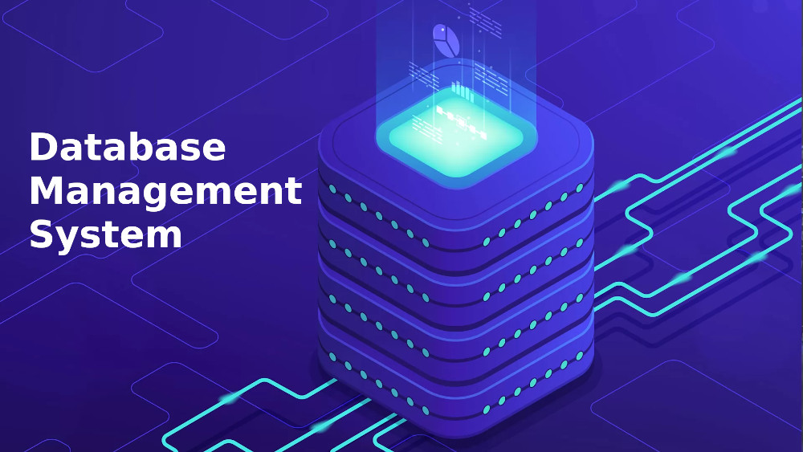
DATABASE MANAGEMENT
The collection of data stored in the place is called data management
TYPES OF DATABASE MANAGEMENT
Relational database management system
Big data analytic database

Slide 11
create , insert , update, delete
creating a table
inserting the values in table
Student name | Student number | Marks | Addmission number
 | 1234
60
78
updating the values or changing the values
deleting the values or removing the values

Slide 12
Relational data base management system

Slide 13
ONE TIER , TWO TIER , THREE TIER
TWO TIER
ONE TIER
Web browser
Internet
THREE TIER
Web browser
Internet
Web server

